Slide 1
Artificial Intelligence & Soft Computing
Subject Code: MCA 4054
Lecture 1

Slide 2
SY MCA Sem-IV Elective -II
Syllabus Discussion
Unit 1: Artificial Intelligence: Role of AI in engineering, AI in daily life, Intelligence and Artificial Intelligence, Different task domains of AI, Programming methods, Limitations of AI Intelligent Agent: Agent, Performance Evaluation, task environment of agent, Agent classification, Agent architecture | Unit 2: Problems, problem spaces and search: Define the problem as a state space search, Production systems, Problem characteristics, Production system characteristic, Issues in design of search program Search Techniques: DFS, BFS, Hill Climbing
Unit 3: Knowledge Representation: Need to represent knowledge, Knowledge representation with mapping scheme, Properties of good knowledge-based system, Knowledge representation issues, AND-OR graph, Types of knowledge | Unit 4: Soft Computing: Hard computing Vs Soft Computing, Soft computing constituents – ANN, Fuzzy Logic, GA, Applications of Soft Computing
Unit 5: Artificial Neural Network: Introduction, Fundamental Concept, Artificial Neural Network, Brain vs. Computer - Comparison Between Biological Neuron and Artificial Neuron, Basic Models of Artificial Neural Network Supervised Learning Network -Linear Separability, Perceptron Networks, Adaptive Linear Neuron (Adaline), Multiple Adaptive Linear Neurons, Back-Propagation Network. Unsupervised Learning Networks-MaxNet | Unit 6: Introduction to Fuzzy Logic, Classical Sets and Fuzzy Sets: Introduction to Fuzzy Logic, Classical Sets (Crisp Sets),Fuzzy Sets Classical Relations and Fuzzy Relations: Introduction, C artesian Product of Relation, Classical Relation, Fuzzy Relations Membership Functions: Introduction, Features of the Membership Functions, Fuzzification, Methods of Membership Value Assignments Defuzzification: Introduction, Lambda -Cuts for Fuzzy Sets (Alpha-Cuts), Lambda-Cuts for Fuzzy Rela tions, Defuzzification Methods
Unit 7: Fuzzy Inference System: Truth Values and Tables in Fuzzy Logic, Fuzzy Propositions, Formation of Rules, Decomposition of Rules (Compound Rules), Aggregation of Fuzzy Rules, Fuzzy Inference Systems (FIS)- Construction and Working Principle of FIS, Methods of FIS, Overview of Fuzzy Expert System | Unit 8: Genetic Algorithm Genetic Algorithm : Basic concepts, Difference between genetic algorithm and traditional methods, Simple genetic algorithm, Working principle, Procedures of GA, Genetic operators- reproduction, Mutation, crossover.
5
6
Self Study
9
2
12
10
4
4

Slide 3
Unit 1 Introduction to AI
[Artificial Intelligence]
AI is designed to identify and understand the thought process of human mind.
1.1 Role of AI in engineering
Some AI driven tools are available in market that use knowledge of the problem domain for decision making.
Example: AI & Expert system technology
Most of the production companies are using Expert system for production line control.
1.2 AI in daily life
1.3 Intelligence & Artificial Intelligence
AI is already in use for:
Human intelligence comprises to two key components:
Identifying credit fraud
1. Learning
=
Processes information
Advising doctors
2. Communication
Production Planning
In 1965, McCarthy defines AI as:
Example: Automatic vacuum gadget
AI is concerned with the design of intelligence
in an artificial device.
Device acts like a human, think like a human.
Notes:
As we know that human brain is a biological computer which is made up of 10¹¹ neurons and these neurons are connected with approximately 1015 links…as the no of neurons increases in human brain the links to connect them will also increase exponentially…So, AI is designed to identify and understand the thought process of human mind.
Automatic Vacuum Gadget: learn and map the logistics of a leaving area. It learns the co-ordinates based on hitting the walls and furniture’s of the home. Once the vacuum cleaner has mapped the room, it can clean the room without even hitting any obstacle.
1.3 Artificial Intelligence
According to definition Intelligence and Device are two basic components of AI concept.

Slide 4
Unit 1 Introduction to AI
[Artificial Intelligence]
Different categories of AI
Symbolic AI
Microscopic Biological Model
Logic Programming
Neural Networks
Knowledge Base System
Reasoning with
uncertainty
Genetic Algorithm
Fuzzy Logic
Soft Computing

Slide 5
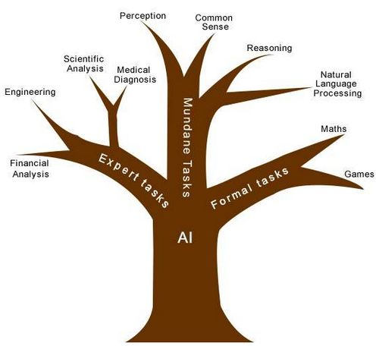
Unit 1 Introduction to AI
[Artificial Intelligence]
1.4 Different Task domains of AI
Mundane (Day-to-day) Tasks
It refers to common tasks that
generally human does every day
Like: vision, speech, understanding
natural language
Formal Taks
These are the tasks where logic and
constraints are considered
Like: board game, playing chess, logic
Expert Tasks
These are the tasks that assign to a
Professional which requires special
expertise.
Like: Engineering graphics,
medical consulting
Notes:
Since all the jobs performed by the system with same skills…therefore there must be a classification of jobs ….by doing this we can have clear cut idea that which tasks are easy or which one is hard.
Tasks are
Mundane ka matalab ROJ MARRA Ke KAM (Day to day work).

Slide 6
Unit 1 Introduction to AI
[Artificial Intelligence]
1.5 Programming methods
Human thought process
Ambiguity
Indistinctness
(No clarity)
AI uses “First order predicate logic”
AI is not used in the application that has a straight forward approach
AI is useful in evolutionary approaches
PROLOG
LISP
Notes:
Programming methods :
Basically human thought process has following problems:
Ambiguity, indistinctness
To handle such problems AI uses “First order predicate logic” . Genrally AI is not used in the application that has a straight forward approach to solve the specific problem. this technique is useful in evolutionary approaches, PROLOG and LISP languages are used for programming.

Slide 7
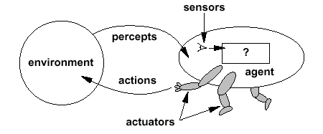
Unit 1 Introduction to AI
[Intelligent Agent]
1.6 Agent
An agent is anything that can perceive its environment through sensors and acts upon that environment through effectors/actuators.
When an agent receives a request to perform an action, it will make its own judgment in search of its goal.
The agent will be most successful if it takes right action on right time.
Agent is the one of the key component of AI.
Notes:
An agent can be a robot or a machine guided by a program which analyse and understand the environment and act upon that or perform some actions through actuators.
So, agent could be a software or a program or any king of machine. Actuators are some times called as effectors also.

Slide 8
Unit 1 Introduction to AI
[Intelligent Agent]
1.6 Agent
An agent should have following properties:
1. Autonomy:
Agent has control over its own movement.
2. Reactivity:
After some duration of time agent will react to change in environment and also agent has the ability to decide when to take action.
3. Proactivity:
Agent has capability to react in a best possible way.
4. Ability to set
goals:
Should be able to set goals according to the requirements.
5. Persistence:
Agent will keep on working… it must not stop.

Slide 9
Unit 1 Introduction to AI
[Intelligent Agent]
1.6 Agent
Examples of agent :
1. Human agent :
Sensors : Eyes, ears, skin, taste buds, etc.
Actuators : Hands, fingers, legs, mouth, etc.
Powered by muscles
2. Robot :
Sensors : Camera, infrared, bumper, etc.
Actuators : Grippers, wheels, lights, speakers, etc.
Often powered by motors
3. Software agent :
Functions as sensors :
Information provided as input to functions in the form of encoded bit strings or symbols
Functions as actuators :
Results deliver the output
Can say powered by S/W

Slide 10
Unit 1 Introduction to AI
[Intelligent Agent]
1.7 Performance Evaluation / Measure
(What I am expecting from agent.)
1. The performance of the agent will be evaluated in terms of Agent Function.
It is done on the basis of what type of o/p the agent is generating according to i/p. For Ex. If it is a cleaning machine then performance will be judged on cleaning quality rather than how much electricity it is consuming. Here only planning is done.
2. AI will design the Agent Program to implement the agent function.
But here actual implementation is done.
1.8 Task environment of agent
Is the place on which agent lives, operates, and gather sense to act upon.
It is a problem to which the solution is rational agent.
Always chooses to perform the action with the optimal expected outcome for itself from among all feasible actions.
Notes:
Performance Measure: Automated Taxi Driver Agent mean automatic machine. What I am expecting from this automatic machine is …
- It should drop my customers to their desired destination.
- It should satisfy my customer by charging lesser cost for ride.
- Machine should take them safely ..it should not bang any where.
Environment: What will around automatic machine? Lots of traffic around it, various roads and every time there will be new customer.
Actuators: By which means my automatic taxi will perform- by steering, Accelerator, clutch and break
Sensors: Since driver is not there then how it will act by sensing the environment. For that it must have Cameras, then GPS to get the location then IR sensors are used to detect the distance between the object and the automatic taxi.

Slide 11
Unit 1 Introduction to AI
[Intelligent Agent]
Automated Taxi Driver Agent
PEAS representation
Performance Measure
Actuators
Getting to correct destination
Accelerators
Less cost
Steering & brakes
Highly safe
Environment
Sensors
Variety of roads
Camera
Traffic
GPS
Different types of passengers
IR sensors
Notes:
Performance Measure: Automated Taxi Driver Agent mean automatic machine. What I am expecting from this automatic machine is …
- It should drop my customers to their desired destination.
- It should satisfy my customer by charging lesser cost for ride.
- Machine should take them safely ..it should not bang any where.
Environment: What will around automatic machine? Lots of traffic around it, various roads and every time there will be new customer.
Actuators: By which means my automatic taxi will perform- by steering, Accelerator, clutch and break
Sensors: Since driver is not there then how it will act by sensing the environment. For that it must have Cameras, then GPS to get the location then IR sensors are used to detect the distance between the object and the automatic taxi.

Slide 12
Unit 1 Introduction to AI
[Intelligent Agent]
Medical Diagnostic System
PEAS representation
Performance Measure
Actuators
Proper Diagnosis of disease
Screen display
Accurate Medicinal Prescription
(Questions→ Treatment → Advice)
Useful advice
Minimum Cost
Environment
Sensors
Patients
Keyboard
Hospital Staff
(To enter symptoms)
Notes:
Performance Measure: Automated Taxi Driver Agent mean automatic machine. What I am expecting from this automatic machine is …
- It should drop my customers to their desired destination.
- It should satisfy my customer by charging lesser cost for ride.
- Machine should take them safely ..it should not bang any where.
Environment: What will around automatic machine? Lots of traffic around it, various roads and every time there will be new customer.
Actuators: By which means my automatic taxi will perform- by steering, Accelerator, clutch and break
Sensors: Since driver is not there then how it will act by sensing the environment. For that it must have Cameras, then GPS to get the location then IR sensors are used to detect the distance between the object and the automatic taxi.

Slide 13
Unit 1 Introduction to AI
[Intelligent Agent]
[1. Simple reflex Agent] In Nature
percepts
(size, motion)
RULES:
(1) If small moving object,
then activate SNAP
(2) If large moving object,
then activate AVOID and inhibit SNAP
ELSE (not moving) then NOOP
needed for
completeness
Action: SNAP or AVOID or NOOP

Slide 14
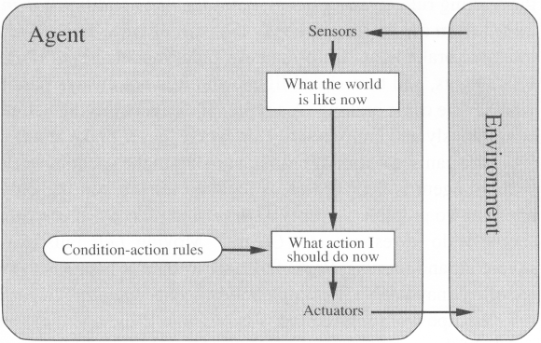
Unit 1 Introduction to AI
[Intelligent Agent]
1.9 Agent Classification [1. Simple reflex Agent]
They choose actions only based on the current percept.
The environment is completely observable.
Condition-Action Rule – there is a mapping between condition and action
1. Thru sensors it will sense what is happening in this environm..
2. Then it will decide what action it should take. Will decide here
Notes:
Jo bhi current situation hai us par ye agent action leta hai.
Chess is the example…the environment is completely observable…if I kill Vajir then Robot whom whith I am playing will try to kill some of my pyada or ghoda
based on current situation.
Agents are autonomous in nature.
Consider cleaning machine: it has self-directed activities.
In any point of time the machine will check for the dirt in particular place.
This shows that agent is taking the autonomous decision.

Slide 15
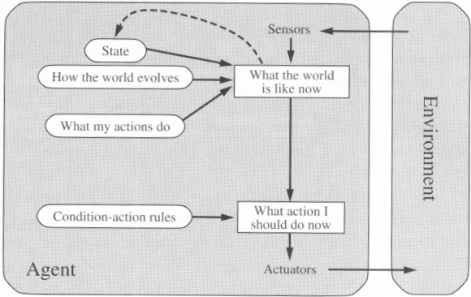
Unit 1 Introduction to AI
[Intelligent Agent]
1.9 Agent Classification [2. Model Based Agent]
Updating the state requires-
How the world evolves
What the agent’s action affect the world.
Model
Notes:
It is used for unobserved state.
To take some autonomous decision the agent should keep track of some extra function…internal State.
For Example: If we consider an automatic car agent apart from all conventional activities, agent has to consider the special case of overtaking other cars.
This action must be self-directed activities, agent has to consider the special case of overtaking other cars; this action must be taken few moments before the overtaking. Due to this the agent should maintain internal state that depends upon current perception history.

Slide 16
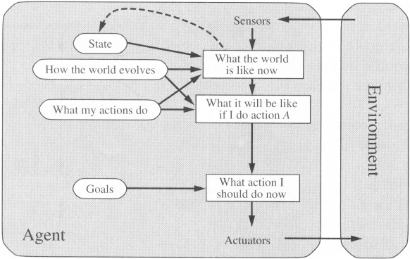
Unit 1 Introduction to AI
[Intelligent Agent]
1.9 Agent Classification [3. Goal Based Agent]
Knowing something about current state of environment is not always enough to decide what to do.
Agent also needs some sort of goal information.
Why this new thing is added here
To check whether am I reaching to the Goal
after performing action A.
If my goal is satisfying then I will take this action.
Notes:
[It says don’t rely on current state only but agent should have some goal information also.]
The agent should move from current state info to the successive stages i.e. it will take decision what to do next.
For automatic car agent on the road, agent has to move right, left, straight ; along with these info. The goal info…destination of this car is equally important.
Goal based approach is more flexible than reflex agent since the knowledge supporting a decision is now explicitly modeled.

Slide 17
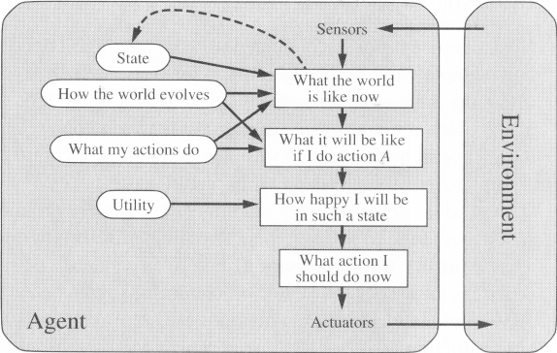
Unit 1 Introduction to AI
[Intelligent Agent]
1.9 Agent Classification [4. Utility Based Agent]
After performing this action, Mujhe kitani Khushi mil rahi hai?

Slide 18
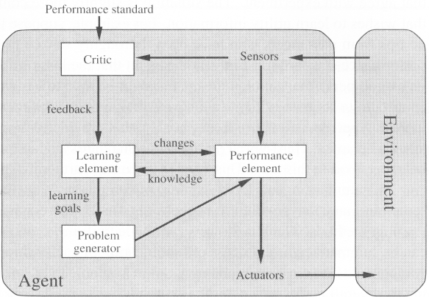
Unit 1 Introduction to AI
[Intelligent Agent]
1.9 Agent Classification [5. Learning Agent]
Example

Slide 19
Unit 1 Introduction to AI
[Intelligent Agent]
1.9 Agent Classification [5. Learning Agent]
1. Critic : It is one who compares sensor’s input specifying effects of agent’s action on the environment with the performance standards and generate feedback for learning element.
2. Learning element : This component is responsible to learn from the difference b/w performance standard and the feedback from critics.
According to current percept it is suppose to understand the expected behavior and enhance standards.
3. Performance element : Based on the current percept received from sensors and the i/p obtained by the learning element.
It is responsible to choose the actions to act upon the external environment.
4. Problem generator : Based on the new goal learn by the learning agent, problem generator suggest new or alternative action which will leads to new and instructive understanding.

Slide 20
Refer Chapter1 & 2 from
AI and SC for beginners
by Anadita Das

